Slide 1
Title I Designee’s Meeting
May 21, 2021
Morena Camp, Parent Educator Coach

Slide 2
What’s Due: June 19, 2021
LCAP/Title I: Graduation Requirements
LCAP/Title I: Attendance
LCAP/Title I: School Choice 1
LCAP/Title I: School Choice 2

Slide 3
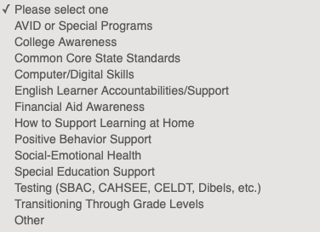

Slide 4
Please KEEP all documents in a binder for 5 years (Flyer, Agenda, Minutes Sign-in, ELAC Recommendation..etc)

Slide 5
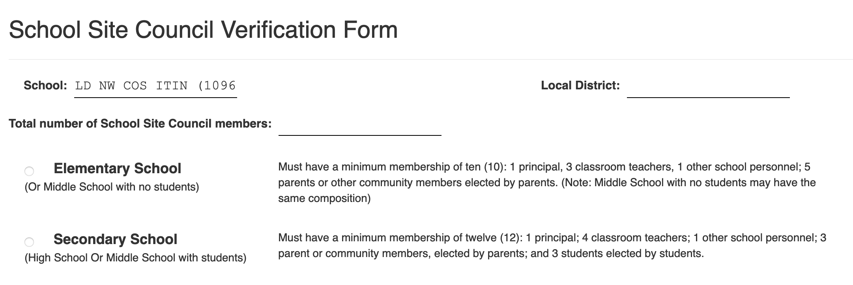
Print and file a hard copy
SSC Verification
ELAC Verification

